Slide 1
Educational Organization Using Serviceniw

Slide 2
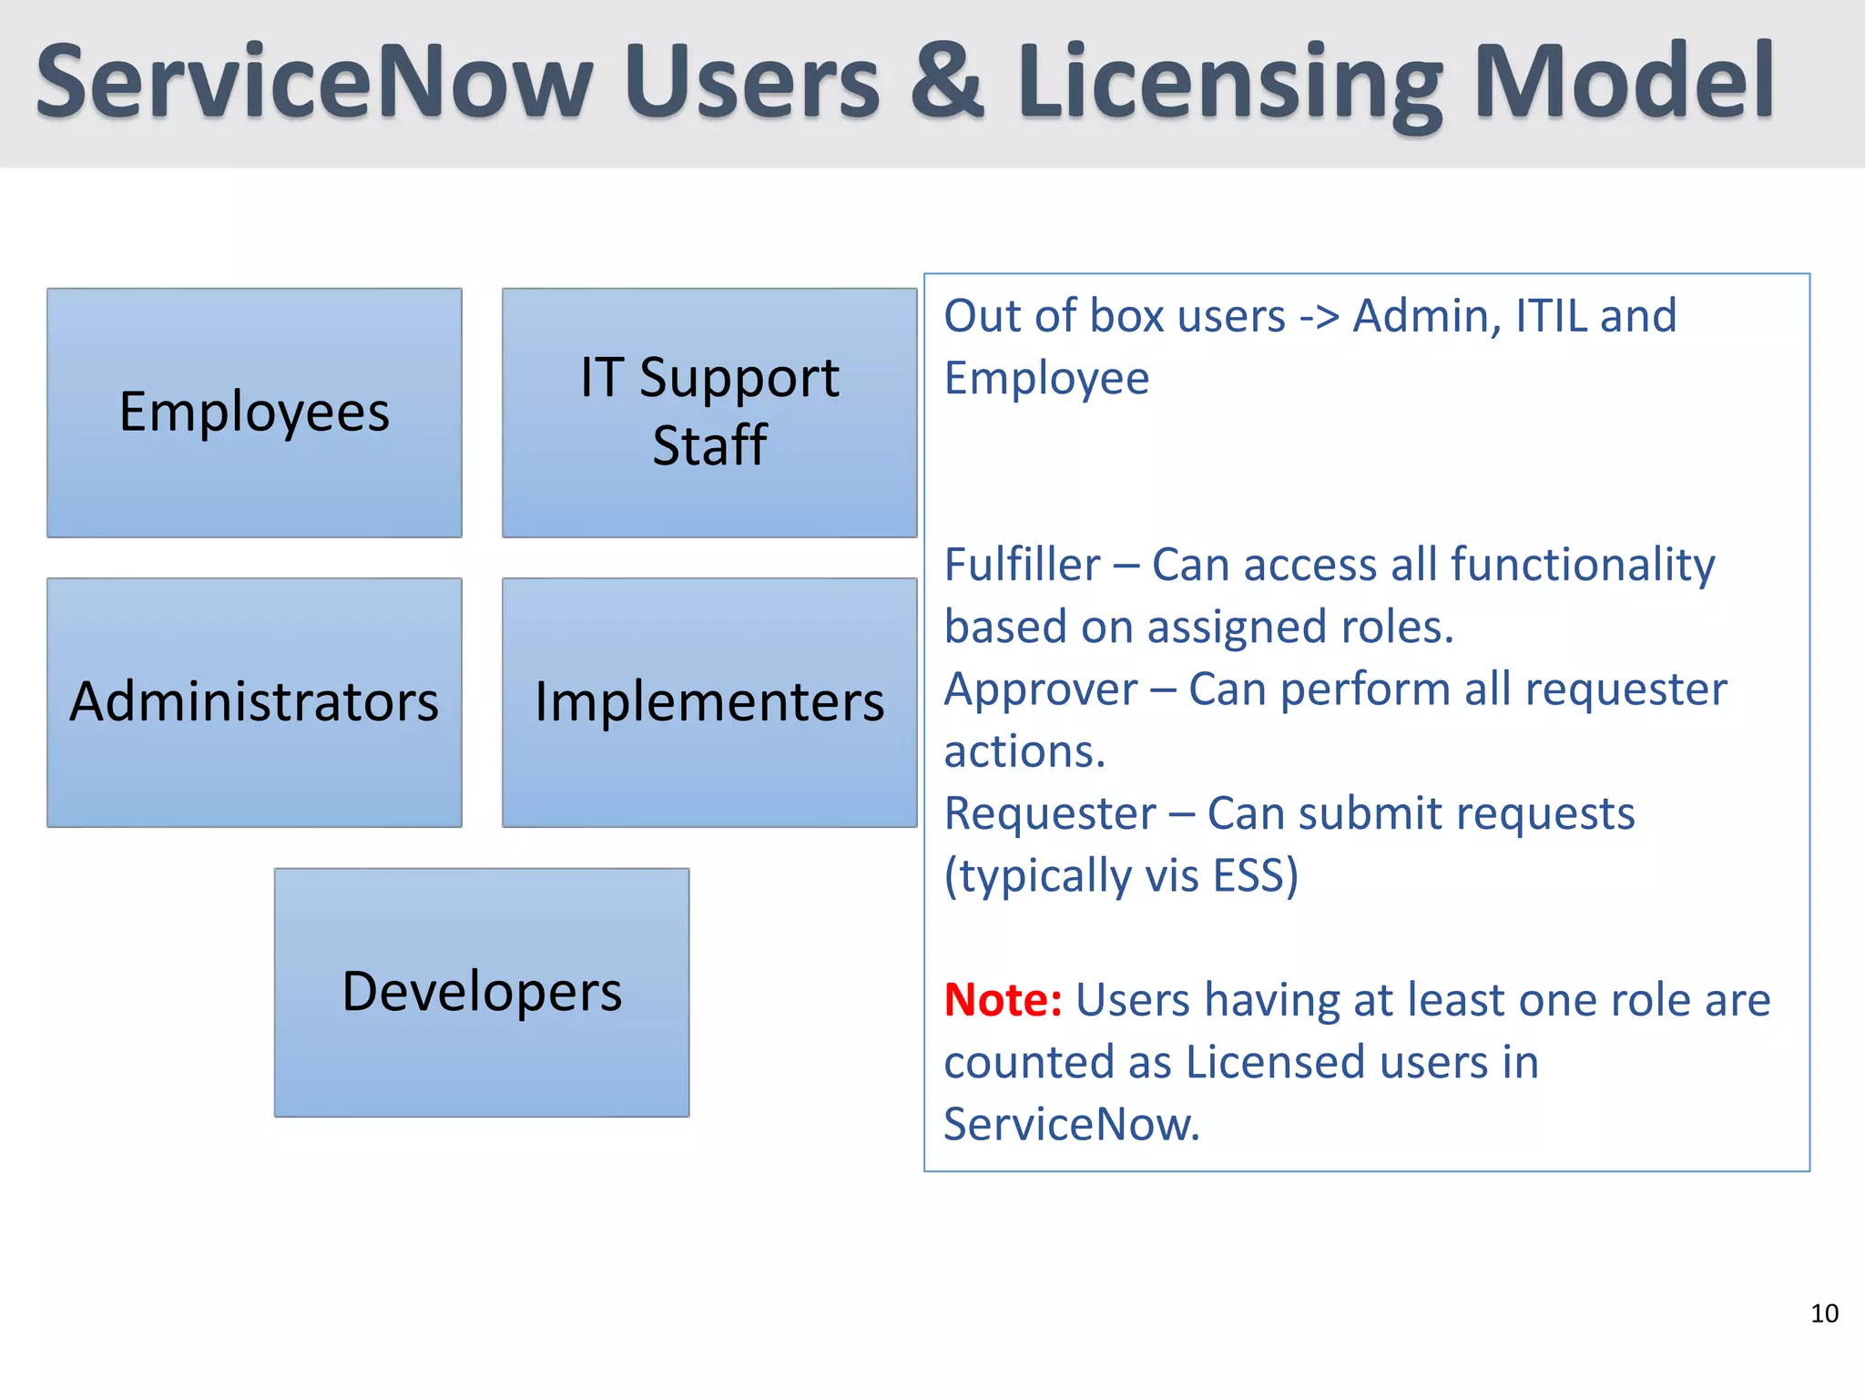
Introduction to Educational Organization Using ServiceNow
ServiceNow is a powerful platform that streamlines administrative and operational processes in educational institutions.
It enhances communication, collaboration, and efficiency among staff, students, and stakeholders.
This presentation explores how ServiceNow can be effectively implemented in educational organizations.
Notes:
Image source: https://image.slidesharecdn.com

Slide 3
Benefits of Using ServiceNow in Education
ServiceNow provides centralized management of student data, courses, and administrative tasks.
It automates routine processes, reducing manual workload and minimizing errors.
The platform improves service delivery, leading to higher satisfaction among students and staff.
Notes:
Image source: https://www.intellilink.co.jp

Slide 4
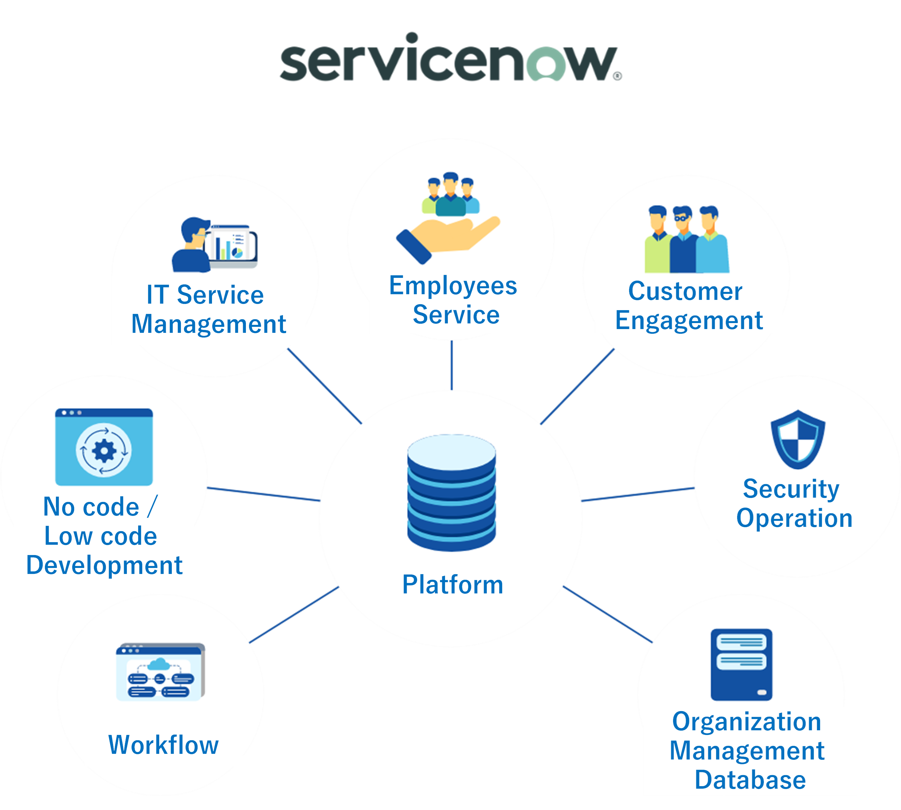
Key Features of ServiceNow for Education
Incident and request management systems facilitate quick resolution of issues.
Knowledge management helps in sharing information and best practices across the institution.
Workflow automation streamlines admissions, enrollment, and other administrative procedures.
Notes:
Image source: https://www.intellilink.co.jp

Slide 5
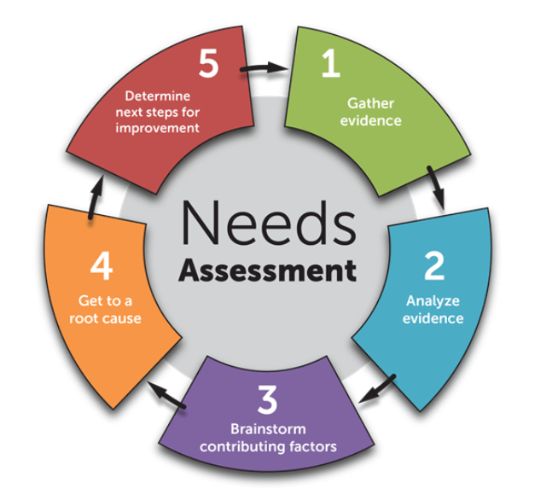
Implementation Strategies
Conduct a needs assessment to identify specific pain points and objectives.
Customize ServiceNow modules to align with the institution’s unique workflows and policies.
Provide comprehensive training and support to ensure smooth adoption by staff and students.
Notes:
Image source: https://www.teamly.com

Slide 6
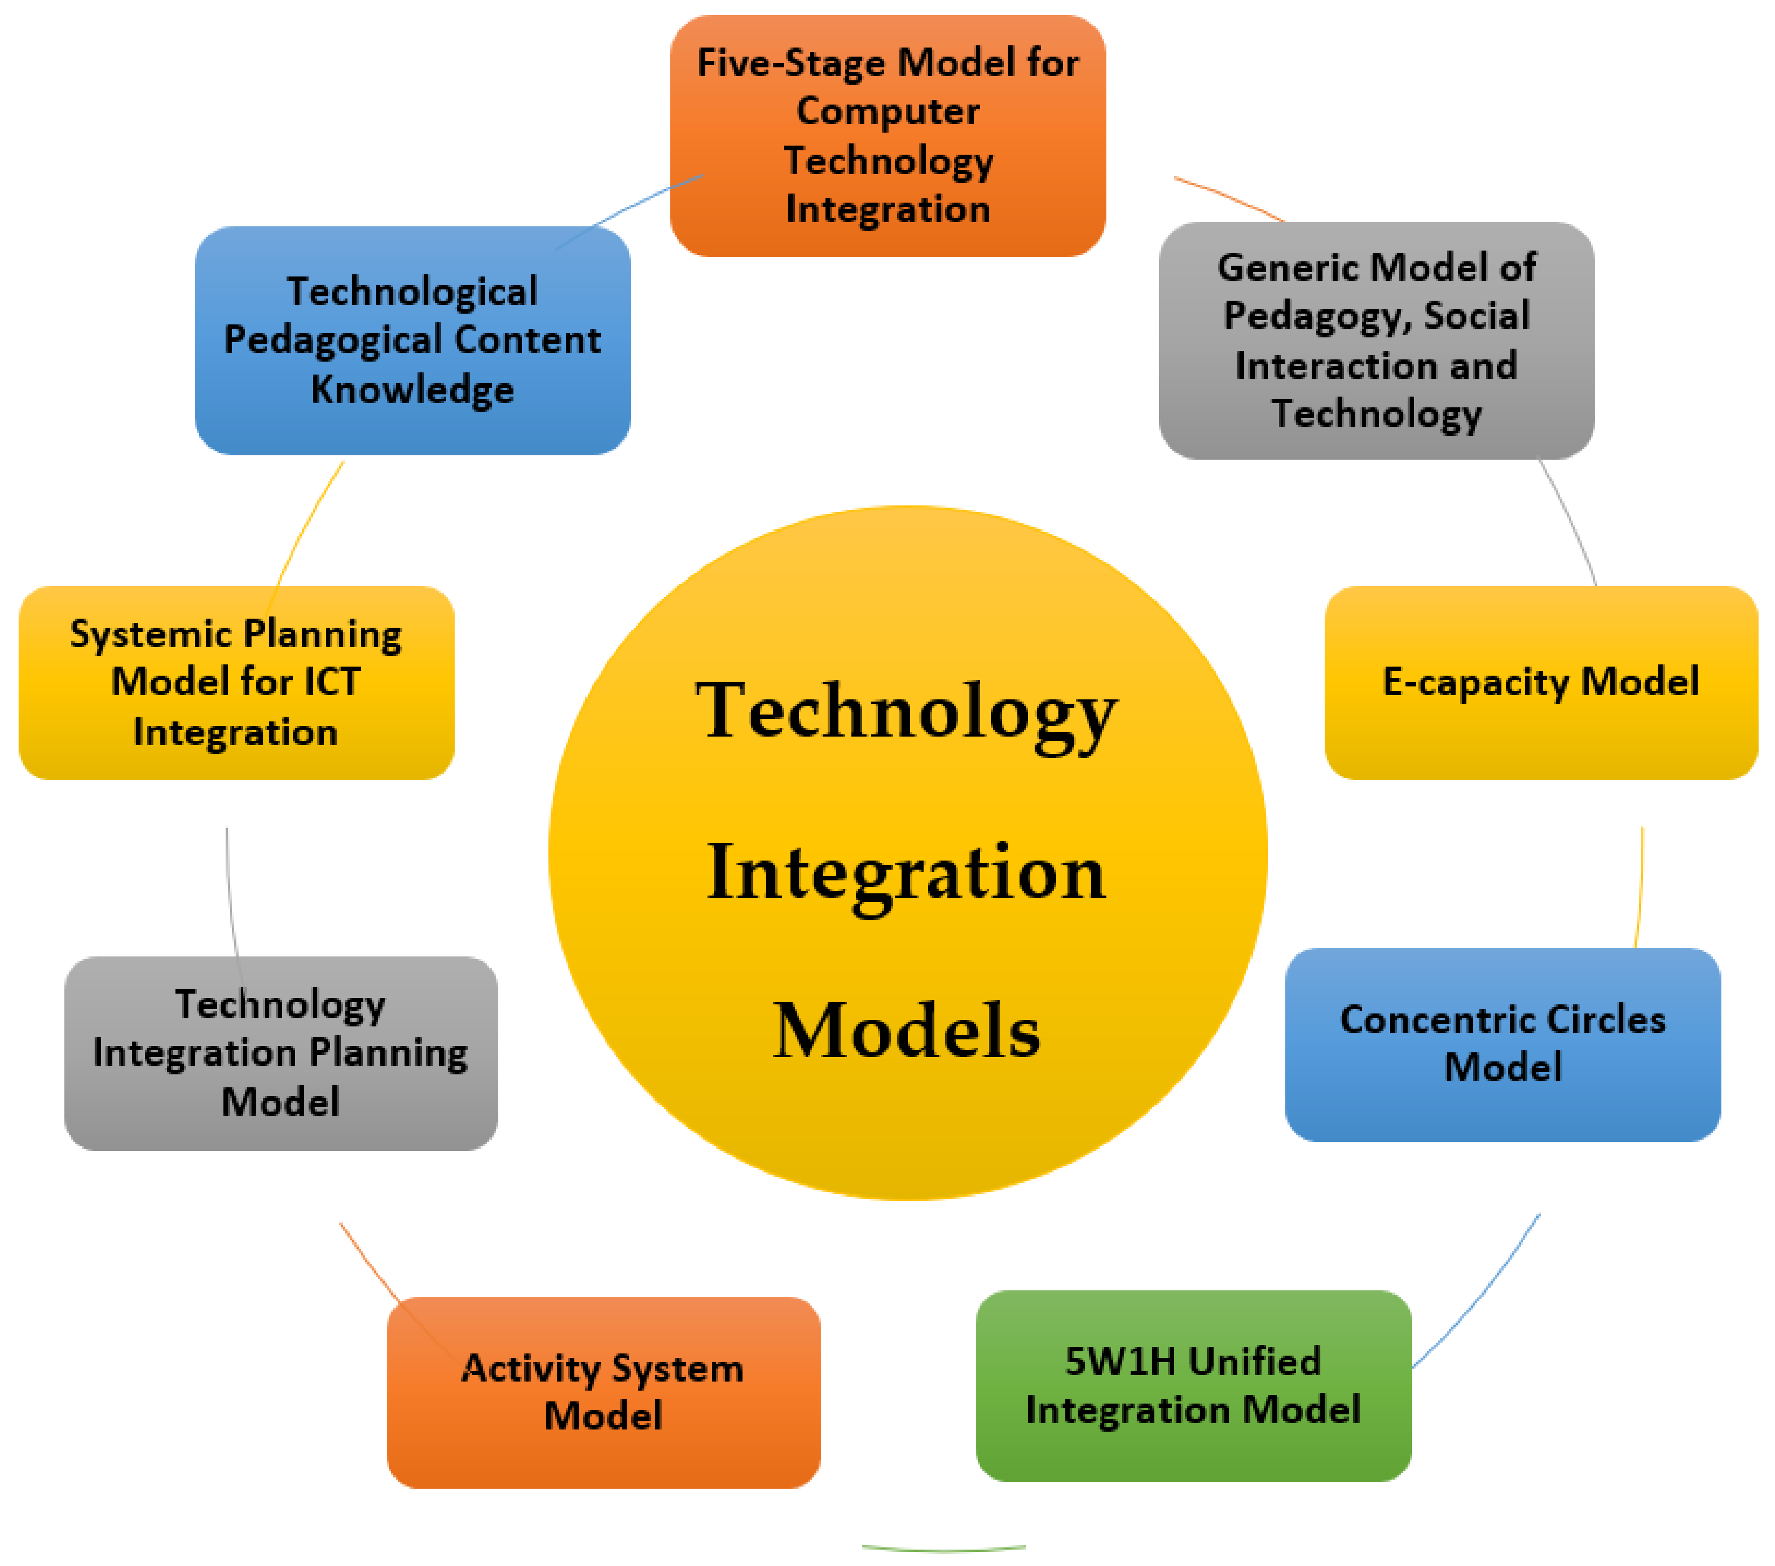
Use Cases in Educational Settings
Automating student onboarding and registration processes for efficiency.
Managing maintenance requests and IT support for campus infrastructure.
Facilitating communication between faculty, students, and administrative staff.
Notes:
Image source: https://www.mdpi.com

Slide 7
Challenges and Solutions
Resistance to change can hinder adoption — address this with stakeholder engagement and training.
Data security and privacy are critical — implement strict access controls and compliance measures.
Integration with existing systems may be complex — plan phased rollouts and testing procedures.
Notes:
Image source: https://digitalpromise.org

Slide 8
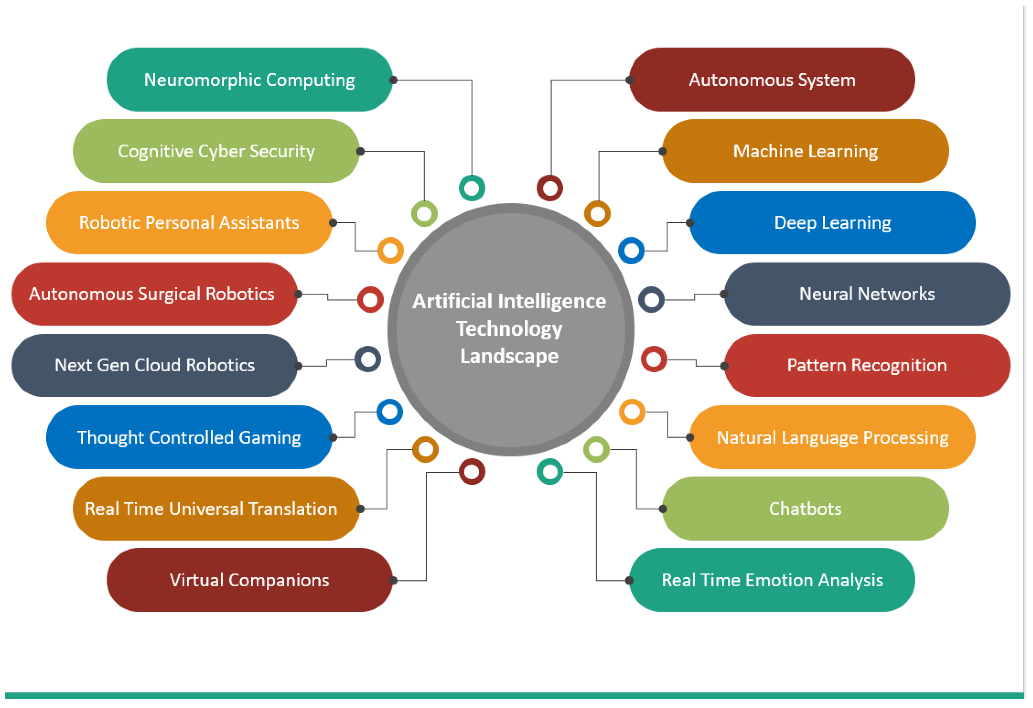
Future Trends and Opportunities
Integration of AI and chatbots for personalized student support and inquiries.
Use of analytics for data-driven decision-making and strategic planning.
Expansion of ServiceNow modules to cover new areas like alumni engagement and fundraising.
Notes:
Image source: https://pub.mdpi-res.com

Slide 9
Conclusion and Summary
ServiceNow offers a comprehensive solution to modernize and optimize educational operations.
Successful implementation depends on careful planning, customization, and training.
Embracing ServiceNow can lead to more efficient, transparent, and responsive educational organizations.
Notes:
Image source: https://www.intellilink.co.jp

